Slide 1

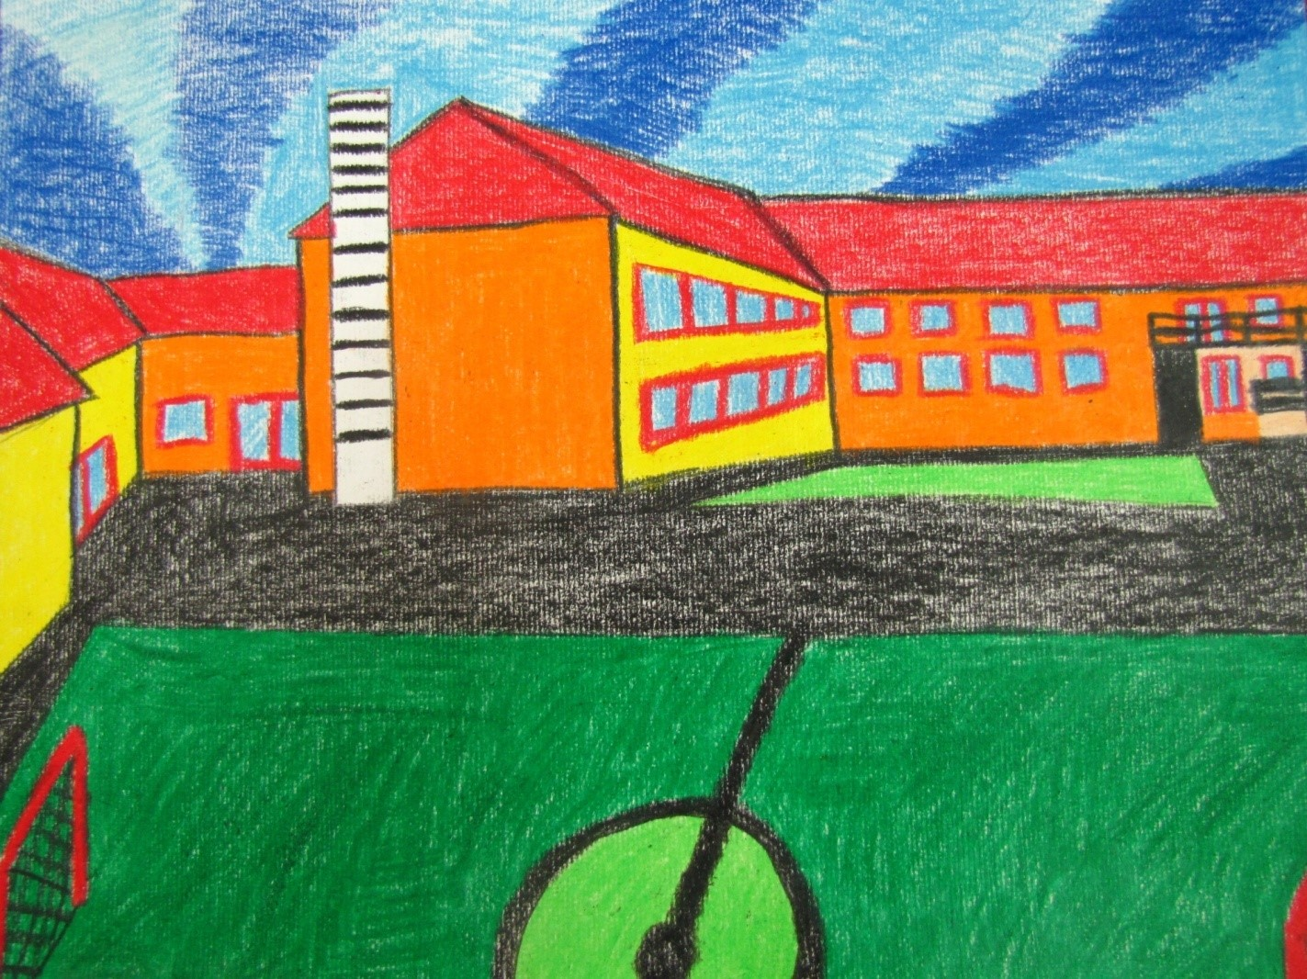
Primary school Bedekovčina
Marta Kokolić
prof.soc.ped.
Prag,
21.-26.4.2025.
Funded by the European Union. The views and opinions expressed are those of the author and do not necessarily reflect the views and opinions of the European Union, which cannot be held responsible for them.

Slide 2
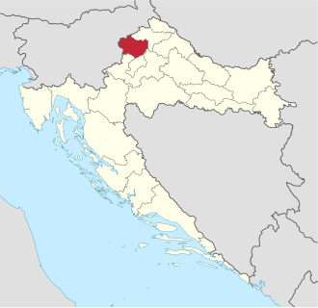


Krapina – Zagorje county
Croatia
Krapinsko – zagorska županija,
Republika Hrvatska
https://hr.wikipedia.org/wiki/Krapinsko-zagorska_%C5%BEupanija
https://kzz.hr/fotogalerija/obiljezja-zupanije-zgrada/

Slide 3
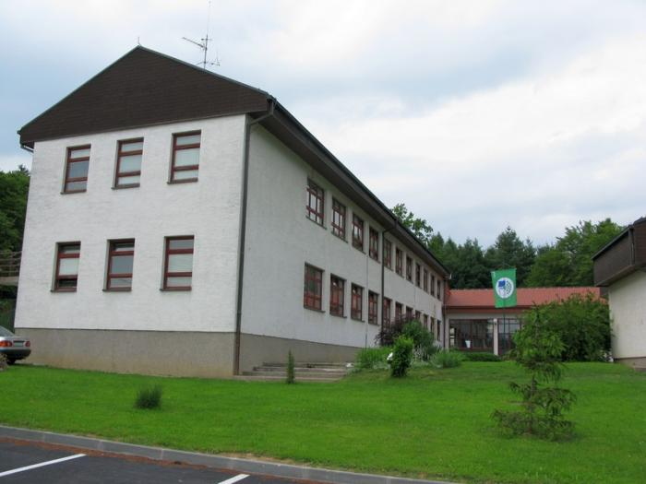
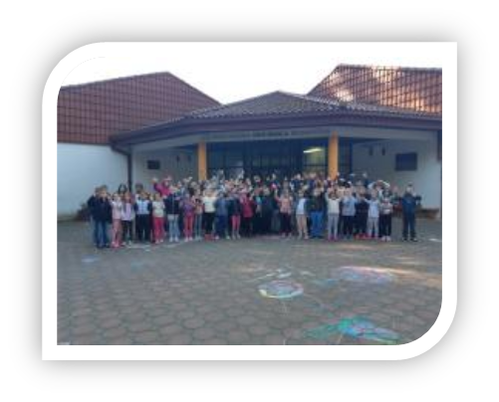

Primary school Bedekovčina
Osnovna škola Bedekovčina
1842. – 2025.
main building in Bedekovčina
around 360 - 370 pupils

Slide 4
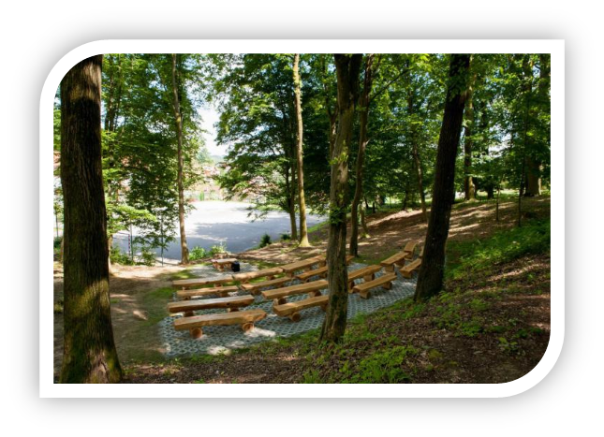
Outdoor classroom
(by the main building)

Slide 5
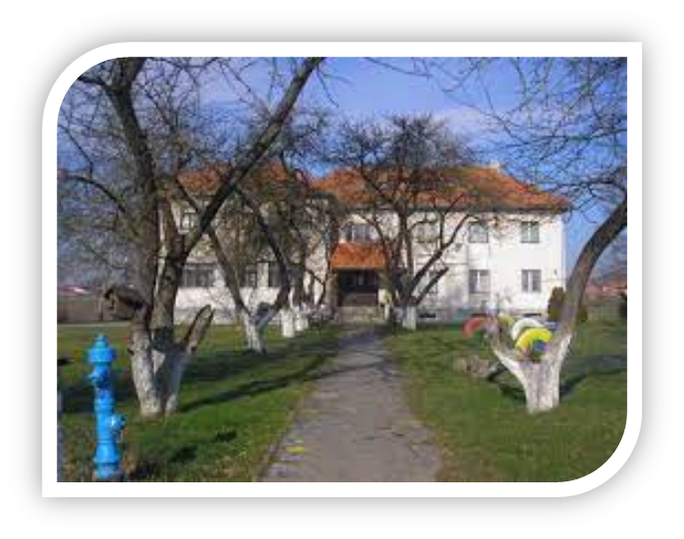
Secondary building in Poznanovec
Područna škola Poznanovec
2,5 km away from the main building
40 – 50 pupils
new construction!!

Slide 6
People and classes
classes: 24 classes (18 + 4)
shifts: school works in 2 rotating shifts
pupils: 1st – 8th grade, 6 – 14 yeras old,
around 405 – 420 per year
School staff: around 35 teachers, principal, librarian, pedagogue and social pedagogue, around 10 administrative and technical staff

Slide 7



Projects and activities
social programs for groups with fewer opportunities
school prevention programs
active children's participation and volunteering
programs for gifted and talented children
Projects/activities – experiential pedagogy
Projects/activities – cultural heritage
etc.

Slide 8

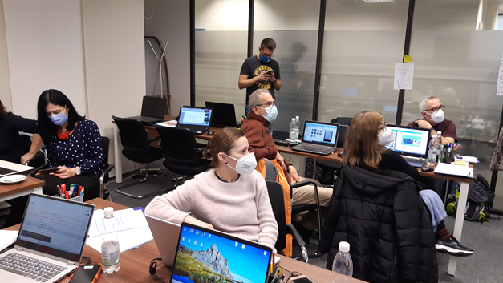
Erasmus+ projects
(from 2018)
3 Erasmus+ KA1 projects – finished very succesfully
1 Erasmus+ KA2 project – (partner school) finished very succesfully
Erasmus acreditation 2023 – 2027
Small partnerships (France)

Slide 9


eTwinning projects
we started along with the 1st Erasmus project to ensure visibility and to connect with other partners
till then: over 30 projects
A lot of Quality Labels
titles of eTwinning school

Slide 10



support for gifted and talented children
Center of excellence for Science in Krapina – Zagorje county, from 2024
https://lumen.kzz.hr/

Slide 11
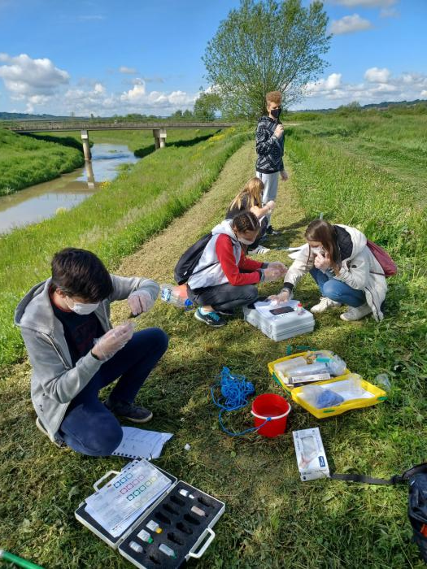
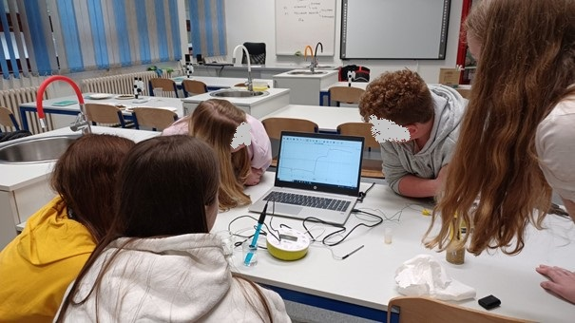
multi-year project "Striving for excellence„

Slide 12
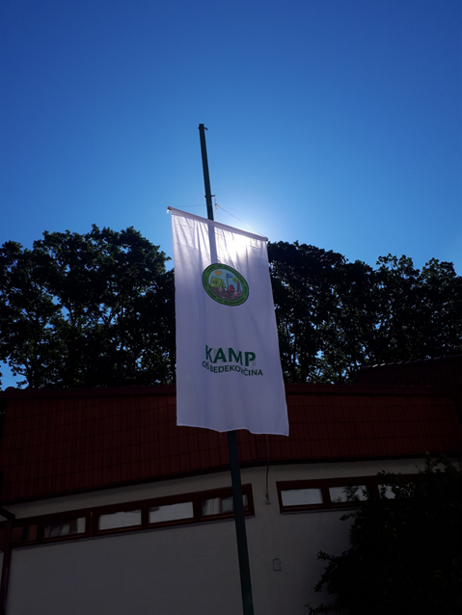
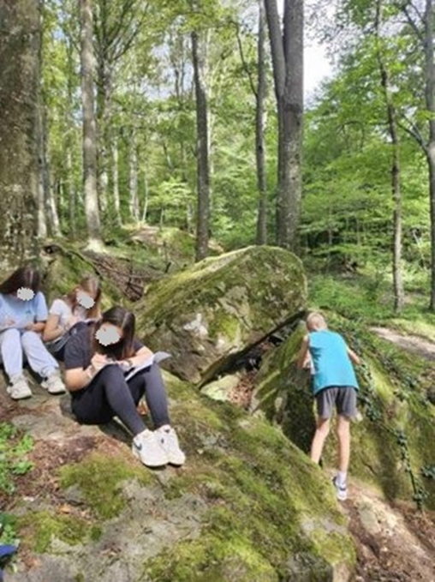
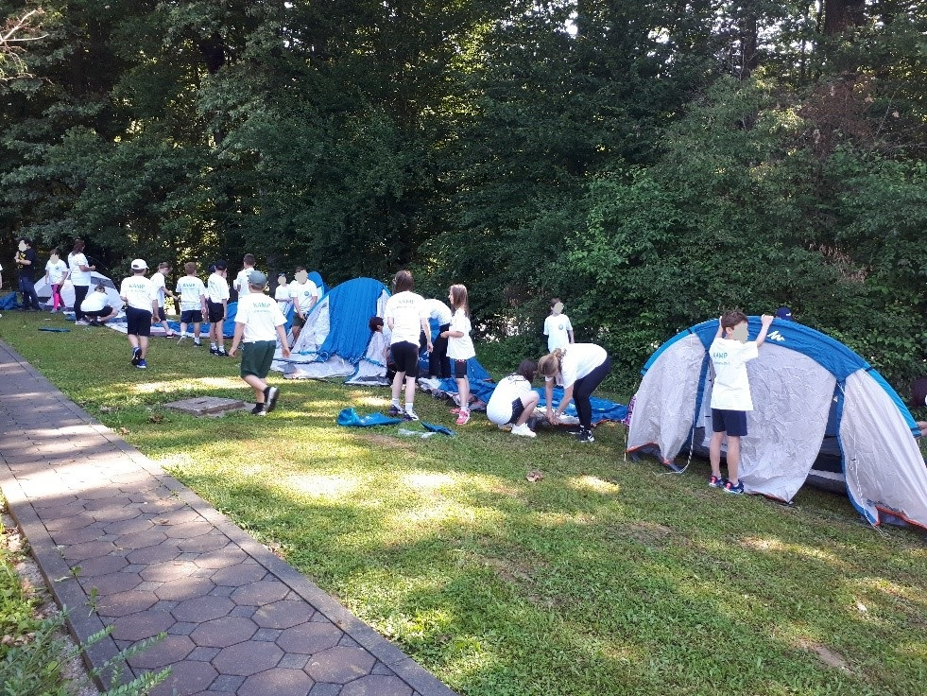
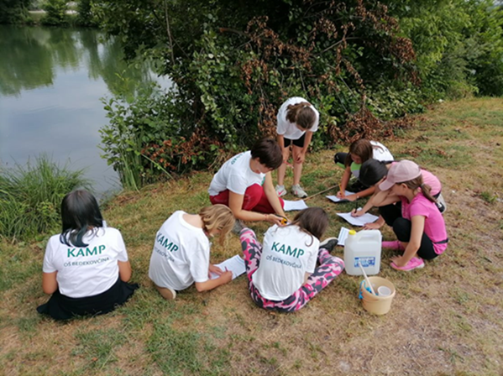
Primary school Bedekovčina camp

Slide 13
Impact on the county and national level
Very good and excellent pupils’ results on the competitions – on county and national level (informatics, school choir etc.)
Excellent results of teachers - advancement in their professional area, members of different work groups
Respectfull status of the school
more: https://os-bedekovcina.skole.hr/

Slide 14
THANK YOU FOR YOUR ATTENTION!

